Slide 1
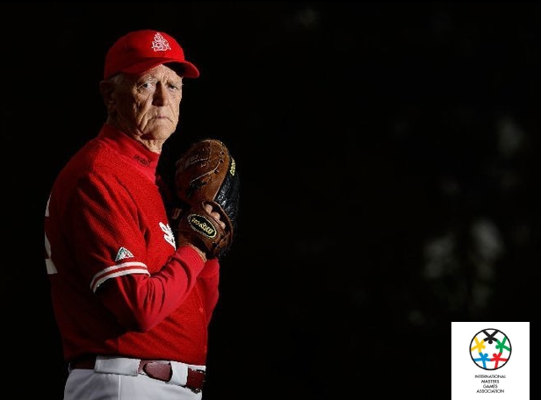
The International Masters Games Association
The IMGA Yesterday, Today and Tomorrow
Jens V. Holm
CEO IMGA

Slide 2
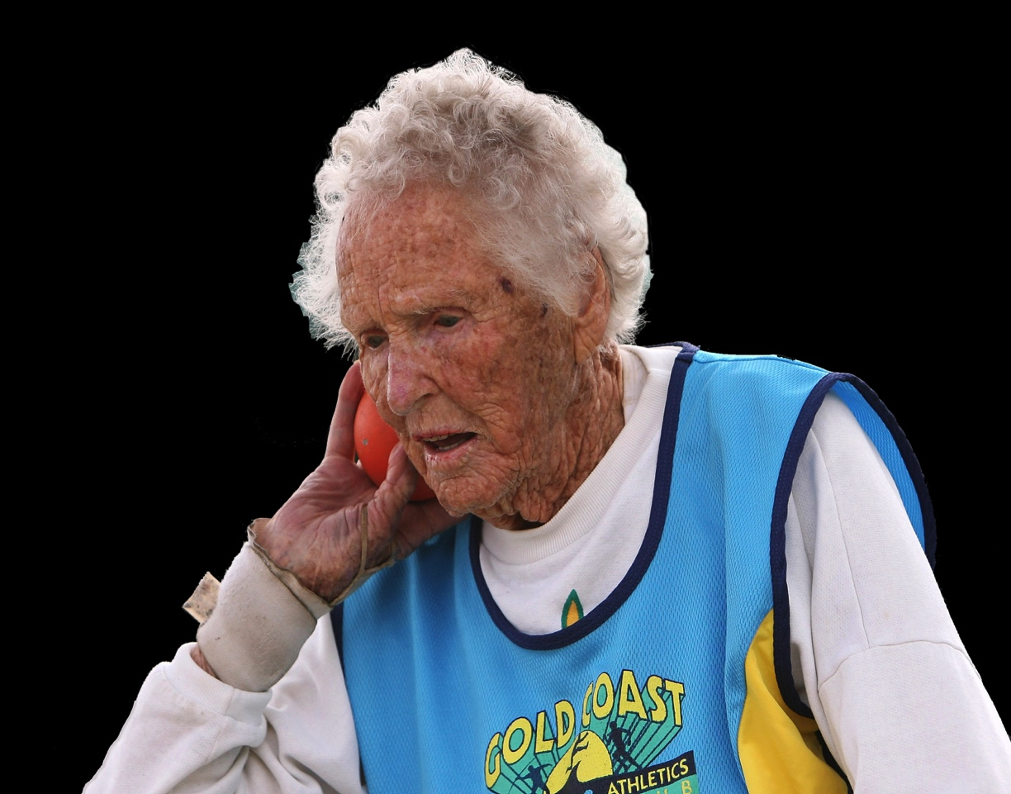
AGENDA
IMGA Yesterday
IMGA Today
IMGA Tomorrow

Slide 3
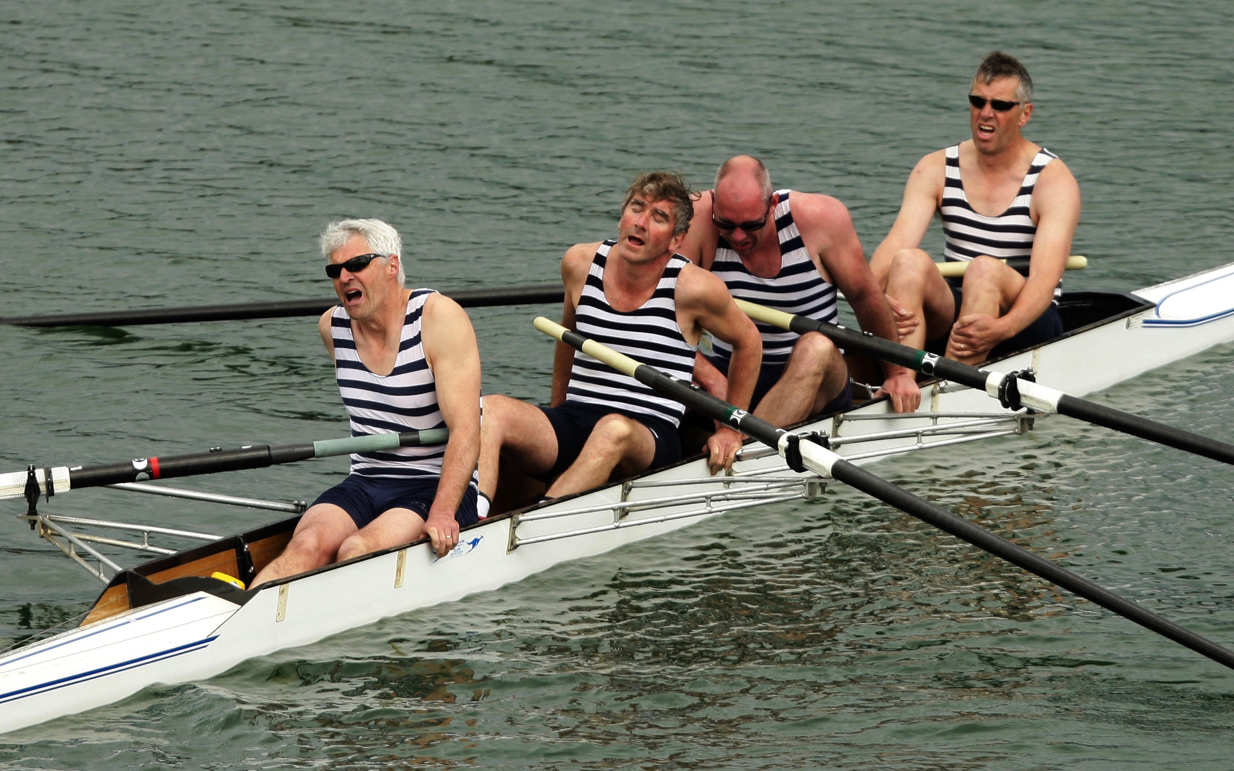
History
In 1970s and 1980s Masters Sport expands significantly
1985 : 1st World Masters Games. Toronto, Canada
Other multisport masters events develop in the late 1980’s (Australia and NZ)
1989 : 2nd World Masters Games. Aalborg, Aarhus and Herning. Denmark
1989 : The Danish Olympic Committee takes ownership of the World Masters Games
1992 : World Masters International is formed
1994 : 3rd World Masters Games. Brisbane, Australia
1995 : World Masters International changes name to International Masters Games Association (IMGA)
1995: IMGA becomes member of GAISF (SportAccord)
1998: 4th World Masters Games, Portland USA
2001: IMGA is recognised by the IOC
2002: 5th World Masters Games, Melbourne, Australia
2005: 6th World Masters Games, Edmonton, Canada

Slide 4
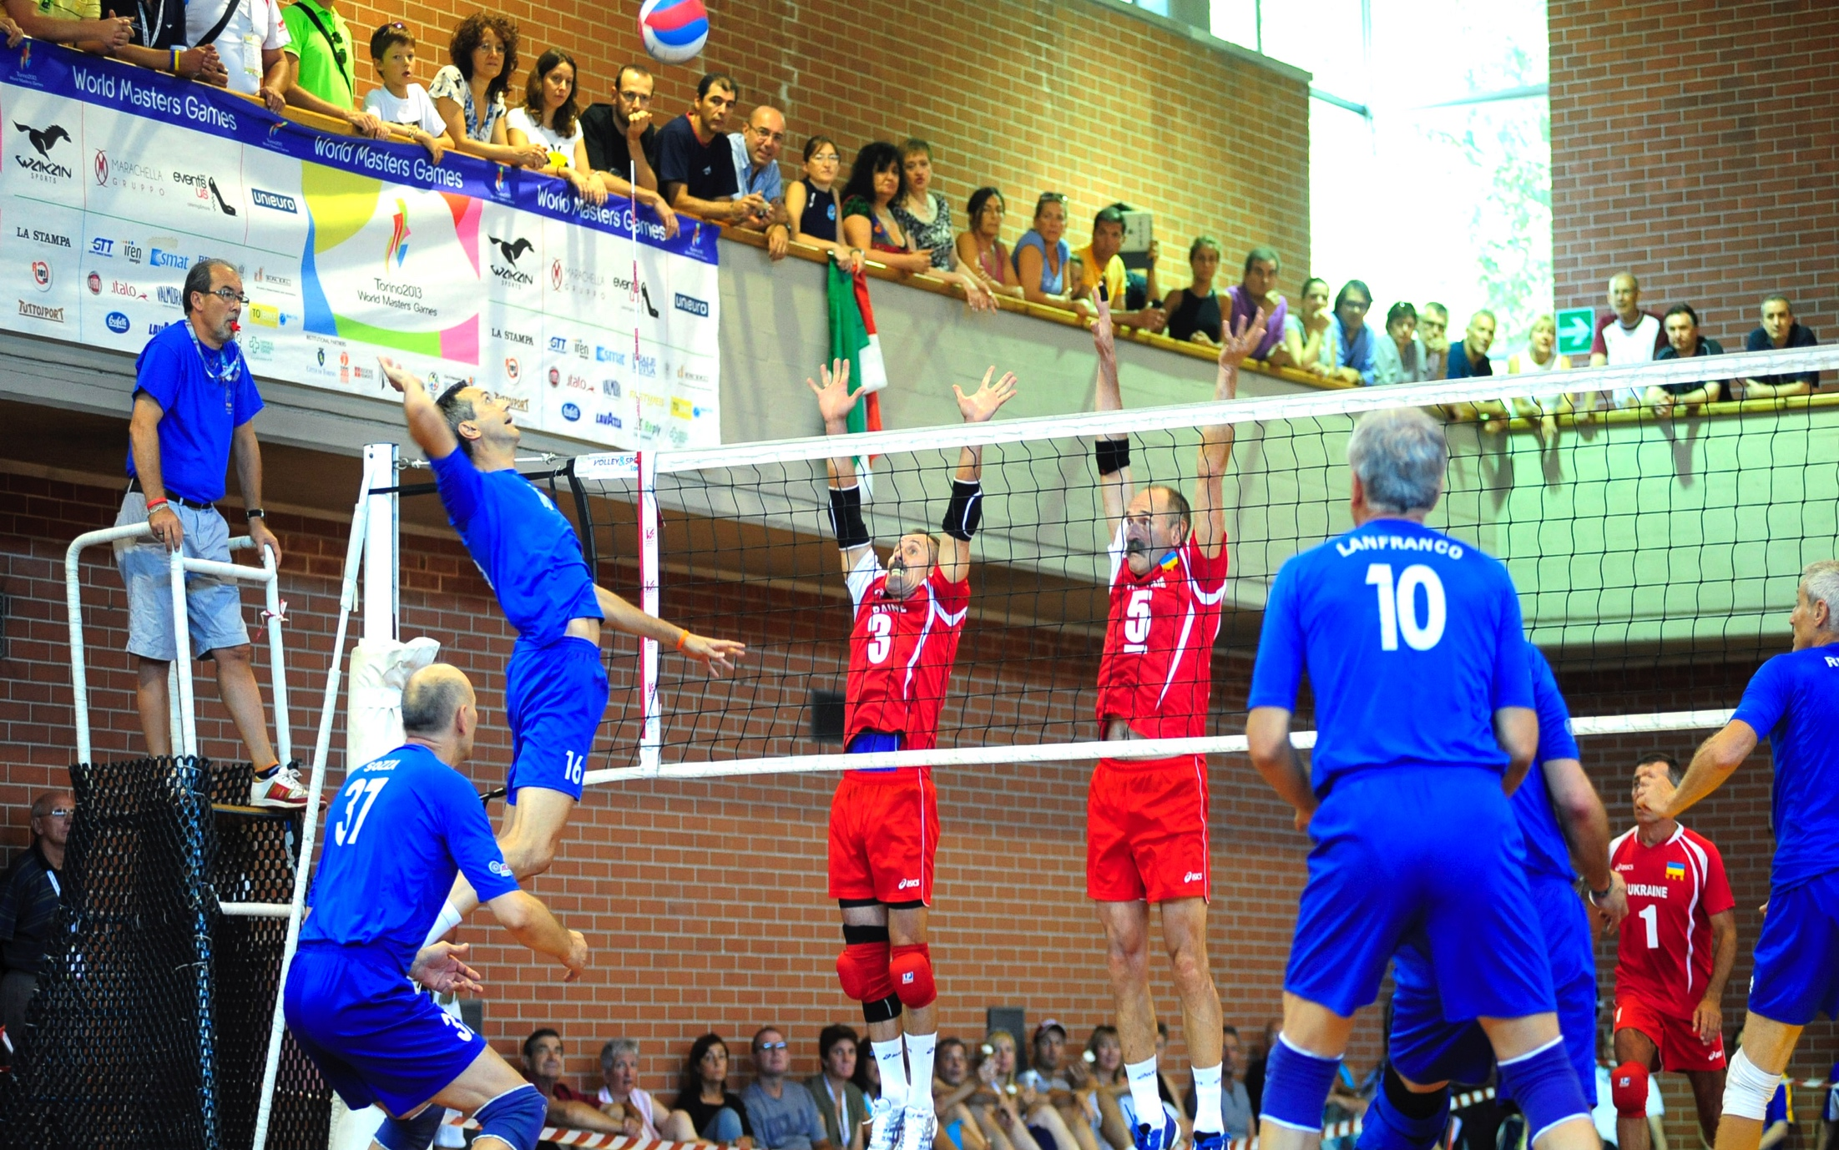
History
2006 IMGA Anti doping rules are approved by WADA
2006 PASO assigns IMGA the rights to Pan-American Masters Games
2008 1st European Masters Games, Malmo, Sweden
2009 7th World Masters Games, Sydney Australia
2009 The World Masters Games is established as the biggest participatory Multi Sports Event with over 33.000 Participants
2010 1st Winter World Masters Games, Bled Slovenia
2011 IMGA enters Partnership with IPC
2011 2nd European Masters Games, Lignano Italy
2013 8th World Masters Games, Torino Italy
2014 At the 127th IOC session IOC members unanimously vote for closer cooperation with the IMGA
2015 2nd Winter World Masters Games, Quebec city Canada
2015 3rd European Masters Games, Nice France The biggest so far with 7500 Athletes
2016 1st Pan-American Masters Games, Vancouver Canada

Slide 5
AGENDA
IMGA Yesterday
IMGA Today
IMGA Tomorrow

Slide 6
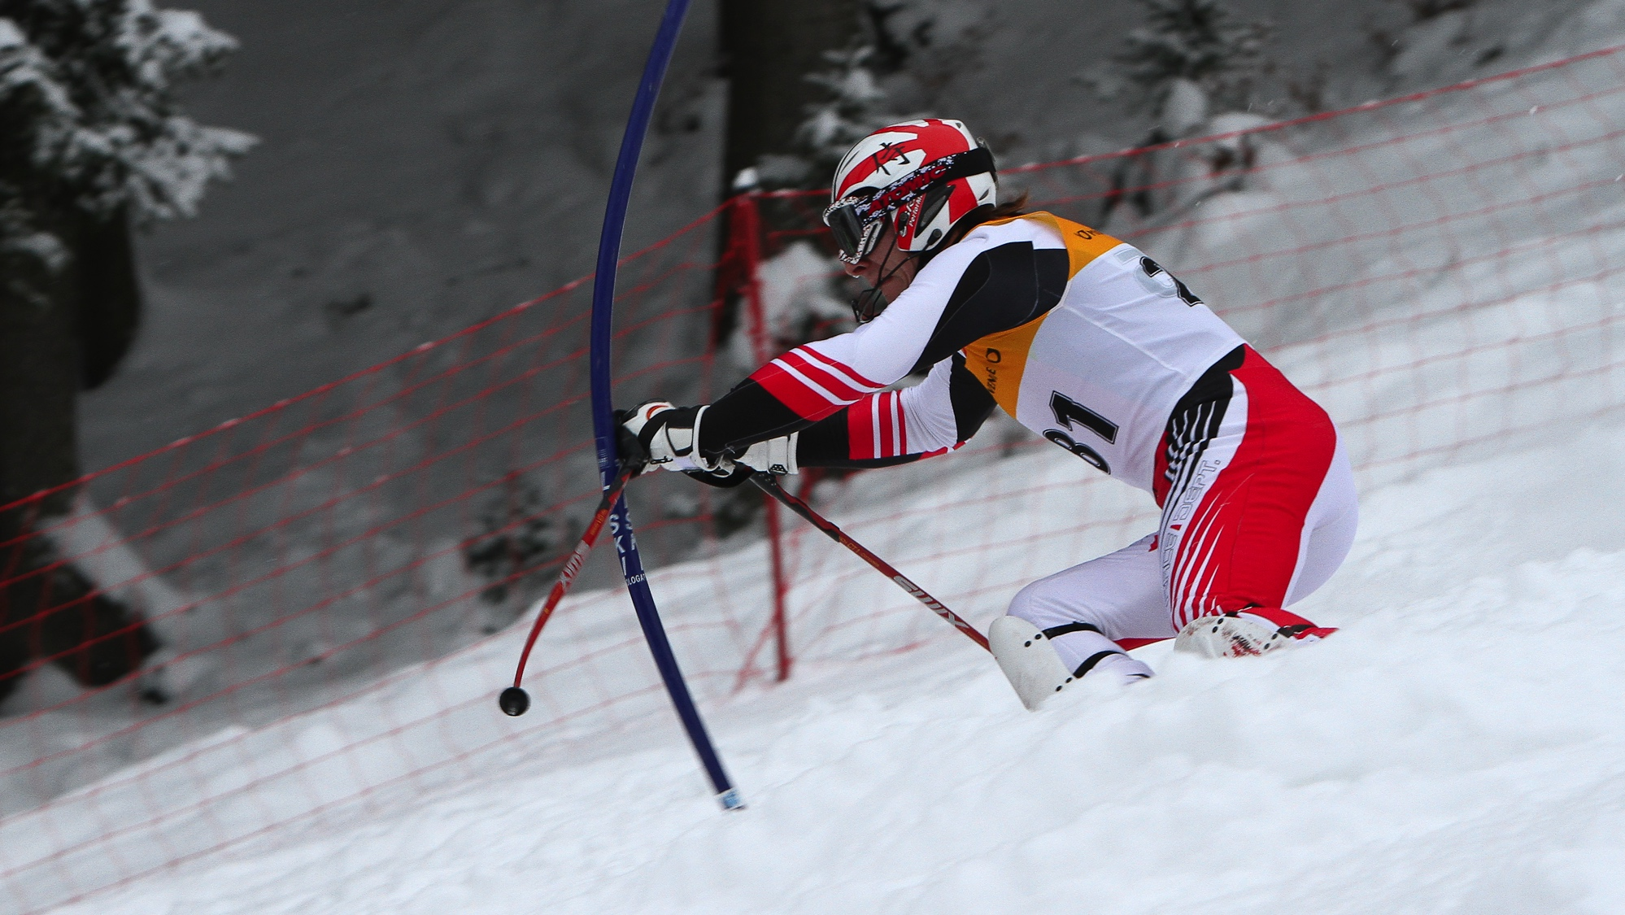




International Masters Games Association (IMGA)
Non-Profit
Self funded
Based in Lausanne, Switzerland
Member of SportAccord
Currently 37 International Sports Federations as members
Recognised by the IOC and the IPC

Slide 7
video

Slide 8
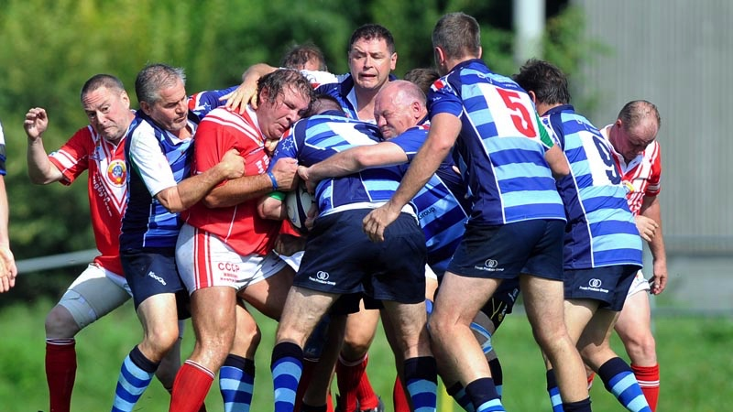
IMGA Objectives
Support the Olympic movement and promote the “sport for all” philosophy of the Olympic charter.
Promoting and encouraging mature athletes from all over the world to practice sports regularly.
Promoting friendship and understanding among mature sports people, regardless of age, gender, race, religion, or sport status.
To grow and strengthen the Masters movement in partnership with our members, the international sports federations

Slide 9
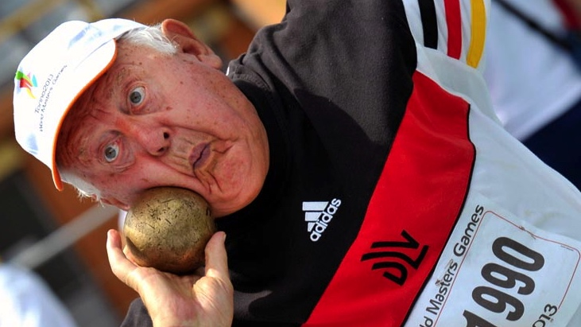
Fundamental Idea
Establish multi-national and multi-sports events for mature athletes
Promoting the philosophy of “sport for life“ and “sport for all”
Motivating a goal-orientated and long-term attitude towards sport and physical fitness
Offering broad-based participation in an open sports event featuring a number of disciplines in a truly multinational environment
Encouraging mature individuals from all over the world to participate in sport regardless of sex, race, religion or sports status
Setting an example by the participants to inspire the youth of the world to acknowledge that competitive sport may continue throughout life
Bringing together mature athletes in different cities throughout the world to practice their sport and to share cultural and tourist experiences.
Notes:
For one 70-year-old, the goal may be to run a marathon, for another it's getting out of a chair.

Slide 10
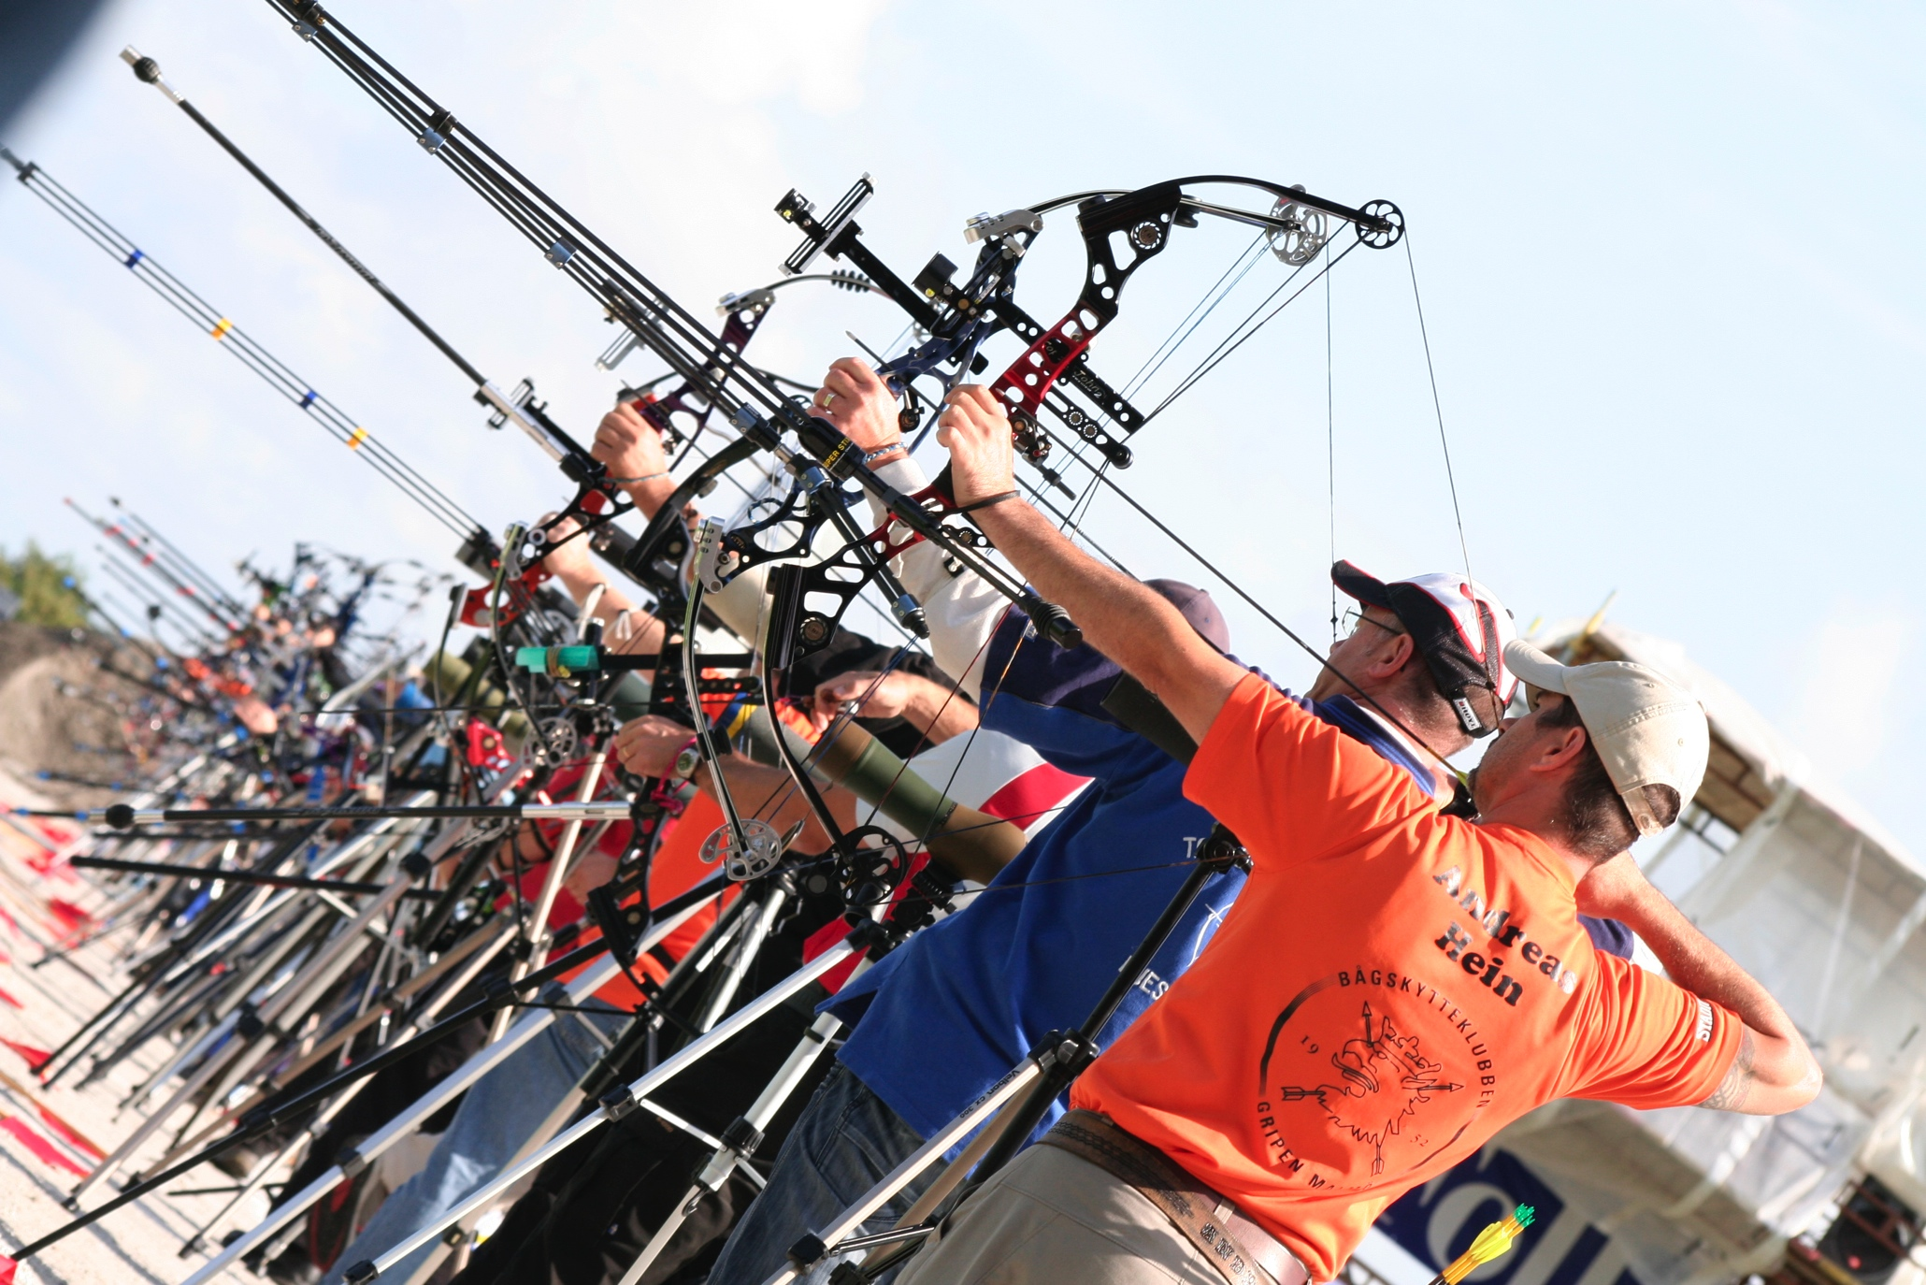
Type of Masters Events
Global Events (Held every 4 years)
  World Masters Games (Auckland, New Zealand 21-30Apr. 2017)
  Winter World Masters Games (Innsbruck, 2020)
Regional Events (Held every 4 Years) All IMGA events are Open to all nationalities
  European Masters Games (Torino, Italy Jul. 2019)
  Asia Pacific Masters Games (Penang, Malaysia Sep. 2018)
  Pan-American Masters Games (TBA 2020) (Bidding: Rio, Cali, Cleveland)
Other Non IMGA events
  Individual sports Masters events
  National Masters events
  Other Masters events

Slide 11
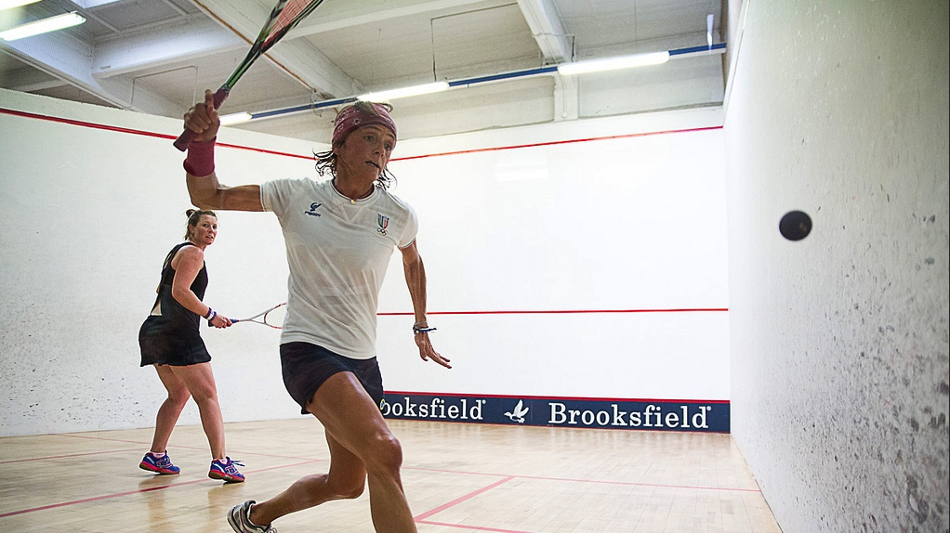
Who is it for
The Games are open to everyone globally, who complies with the minimum age requirements and who registers for the sport(s) in which they wish to participate.
All participants represent themselves only.
There are no national teams, groups or official national representatives.
With regard to team sports, it is accepted that several teams from individual countries may participate, while participants from several different countries may unite to form multi-national teams.
All participants shall compete in the outfit and the clothes normally used in their particular sport. Participants may wear their national uniforms; however this is at the discretion of the participants and their national sports organisation.
Participation in a IMGA Masters Games does not require any qualification competitions or selection criteria.
Participants, their family and friends will be offered a range of accommodation options, which will satisfy any individual need and budget. The establishment of a Games athlete’s village is not a requirement.
The Games offers an opportunity for Paralympic athletes to compete alongside or in the same field of play as able-bodied athletes.

Slide 12
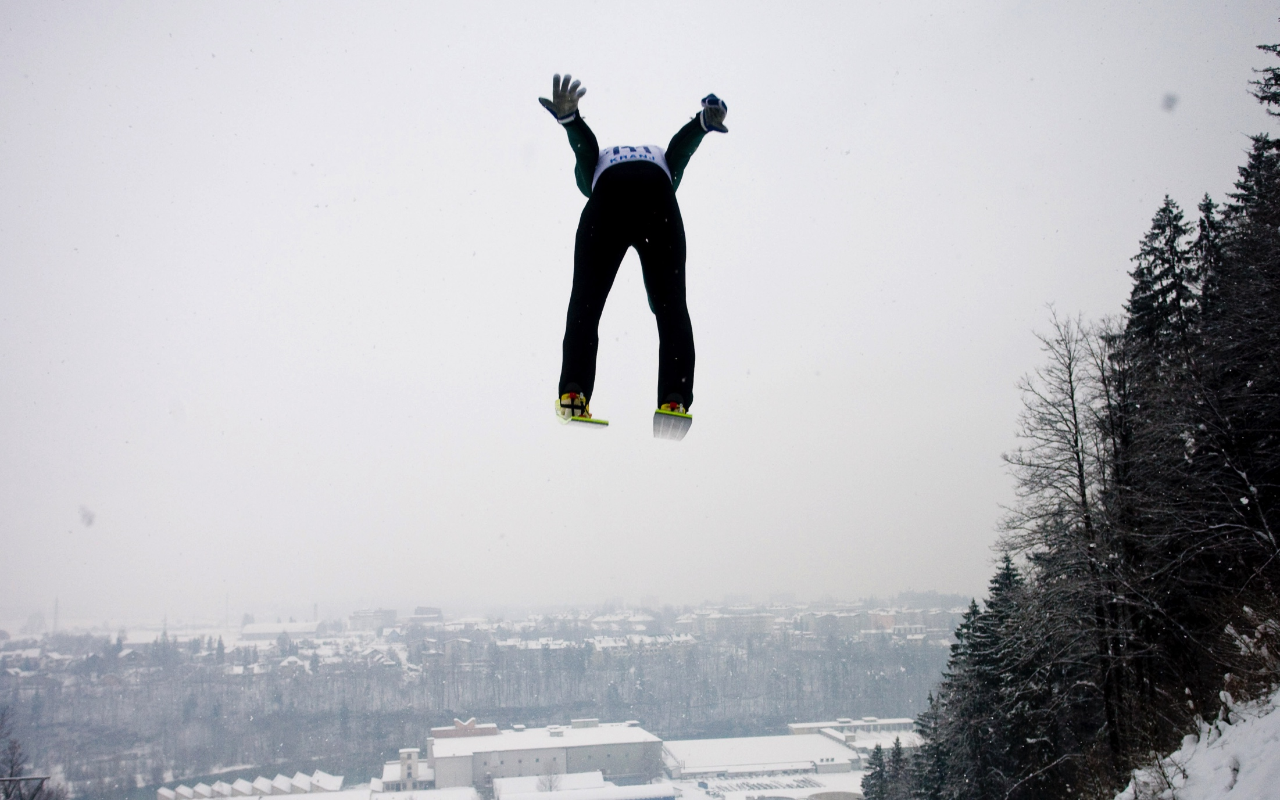
IMGA Masters Events in Numbers
World Masters Games
  25000+ Athletes, 30 sports, 70+ Venues, 10 days, 20M EUR budget
Winter World Masters Games
  4000+ Athletes, 8 Sports, 20+ Venues, 9 days, 3M EUR budget
Regional IMGA summer events
  5000-10000 Athletes, 25
  Sports, 9 days, 40+ Venues, 5M EUR budget

Slide 13
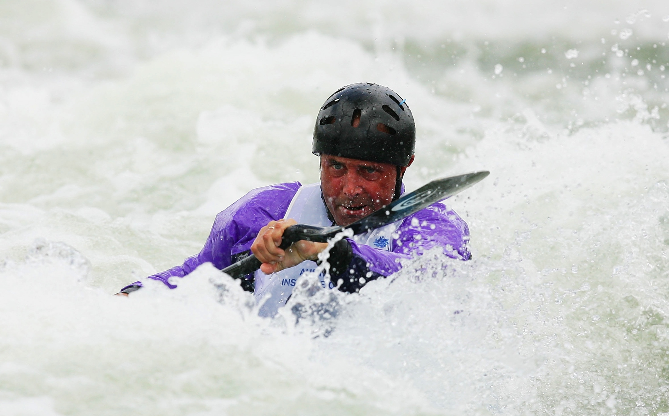
Economic Impact
Torino
World Masters Games 2013
Hotel Occupancy 36% to 71%
Avg. Rate EUR 71 to EUR 104
Total Operating Cost: EUR 6.7 Million
Public Funding: EUR 3.3 Million
Direct Tourism Spending:
  EUR 35 Million
ROI
  10 times
Nice
European Masters Games 2015
Hotel Occupancy 33% to 92%
Total Operating Cost: EUR 3.9 Million
Public Funding: EUR 820.000
Direct Tourism Spending:
  EUR 15 Million
ROI
  18 times

Slide 14
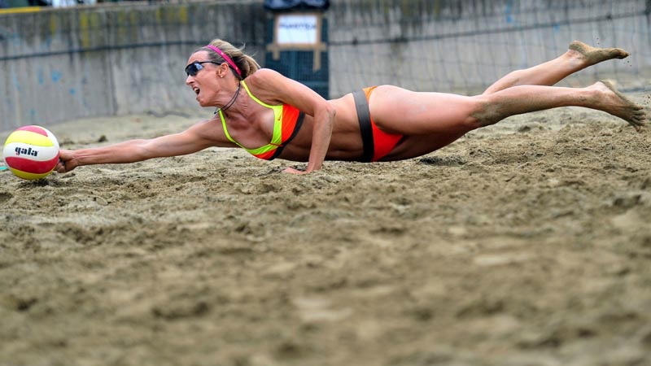
Social Impact
Masters sport can make a great difference. Masters Sport can affect positive change in many ways within society and must begin to be seen as a valuable public asset. Evidence points to sport as a very rich source of key developmental assets which can help to:
build health both mentally and physically
foster character and citizenship
social integration
stimulate the local economy,
provide adult mentorship to young people and teach kids important life lessons
strengthen community connectedness
build social capital and resilient communities

Slide 15
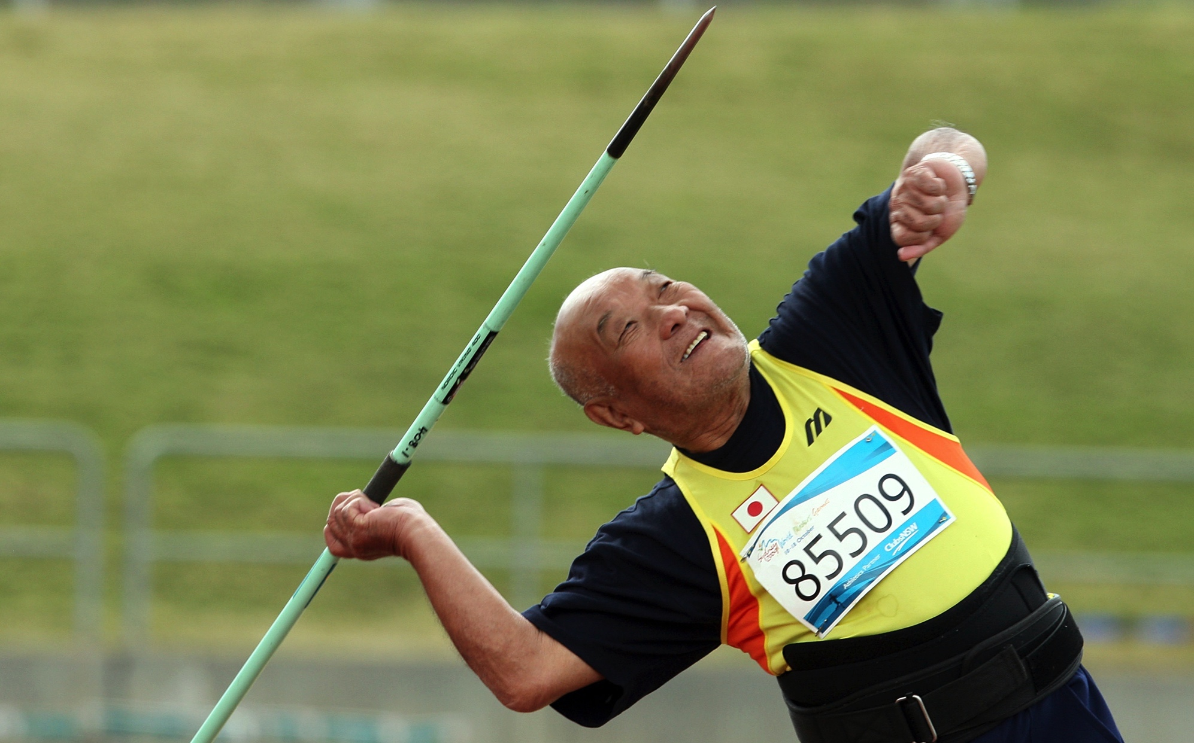
What is IMGA looking for in a host city
Sports infrastructure
  Venues availability, quality and ownership
  Local or regional experience in event management
Finances
  Payment history at previous international sports events
  Solid budget, including cash flow considerations.
Tourism infrastructure
  Hotels
  Other Accommodation
  Tourist attractions : Museums. Tour options etc..
Location
  Local neighbouring Masters population
  Accessibility: Airport proximity, Other transport
Dates
  When is the event suggested, local holidays etc.

Slide 16
AGENDA
IMGA Yesterday
IMGA Today
IMGA Tomorrow

Slide 17
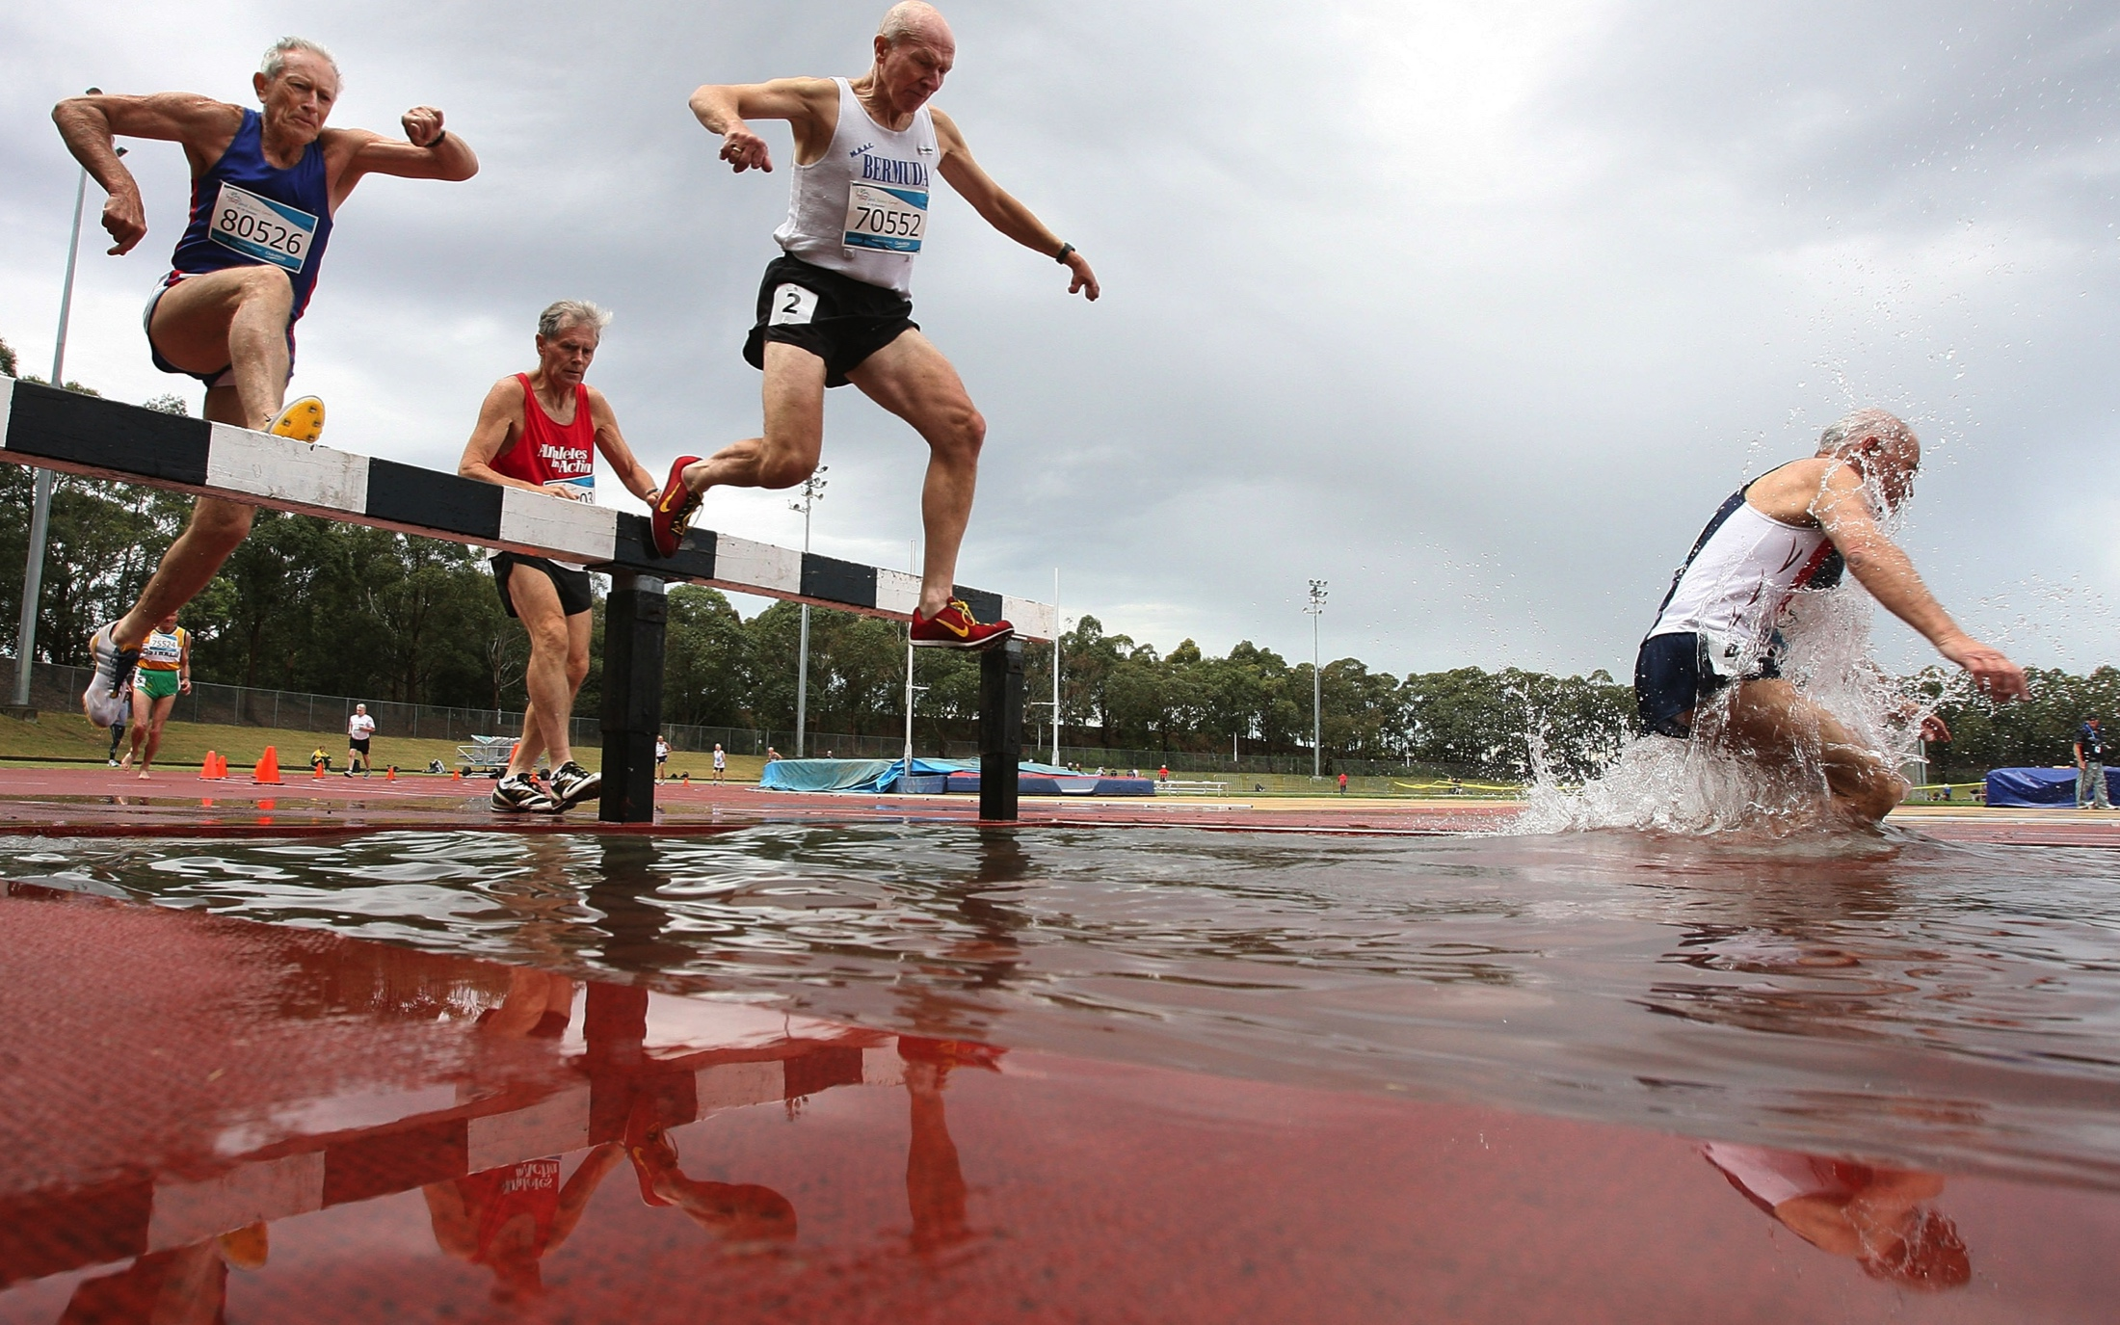
Next steps
The IMGA has signed an agreement with the Olympic Committee for the World Masters Games and Winter World Masters Games to be hosted in Olympic cities, preferably in the year following the Olympic and Paralympic games.
The IMGA has entered into an agreement with an international media house to centralise and distribute media related to the Masters movement globally.
Apart from having a Masters event every year the IMGA will seek to help and encourage individual nations to host their own Masters Events
Continue to grow and strengthen the Masters Movement

Slide 18
video

Slide 19
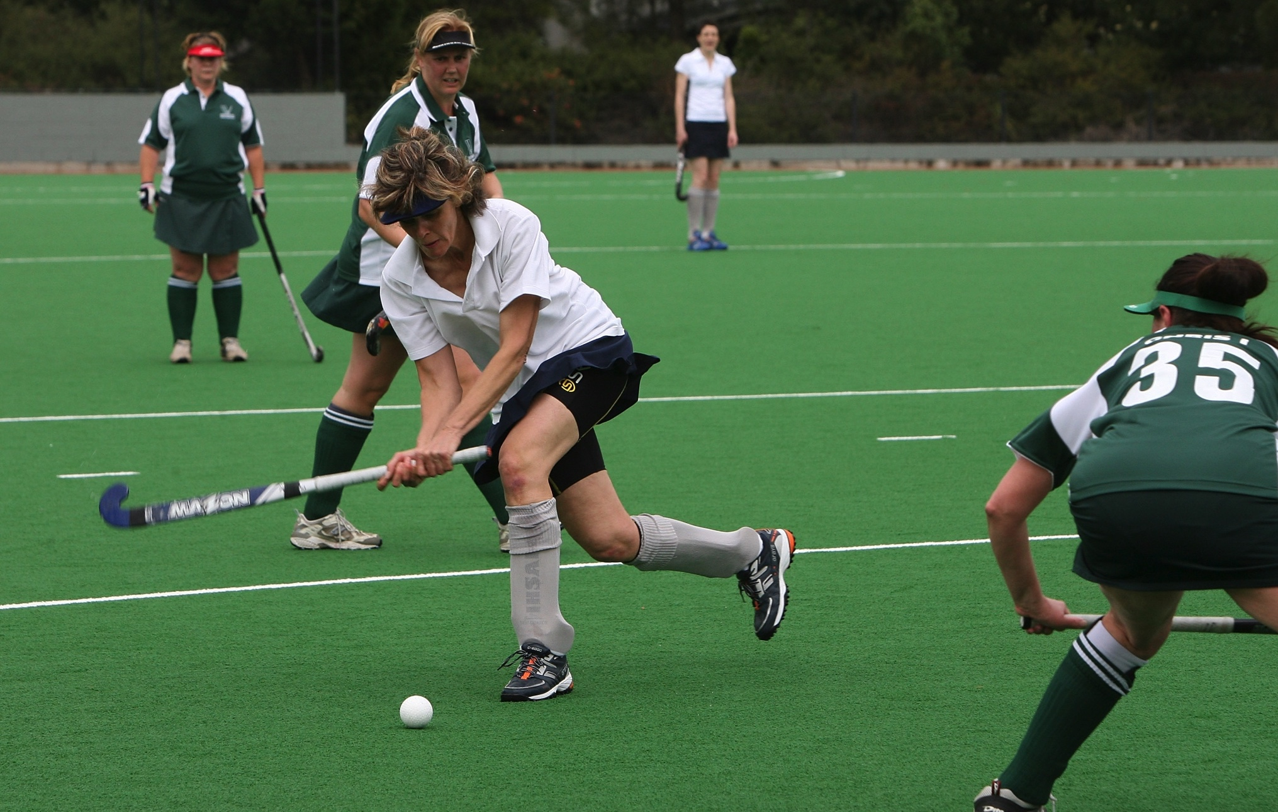
Questions ?

Slide 20
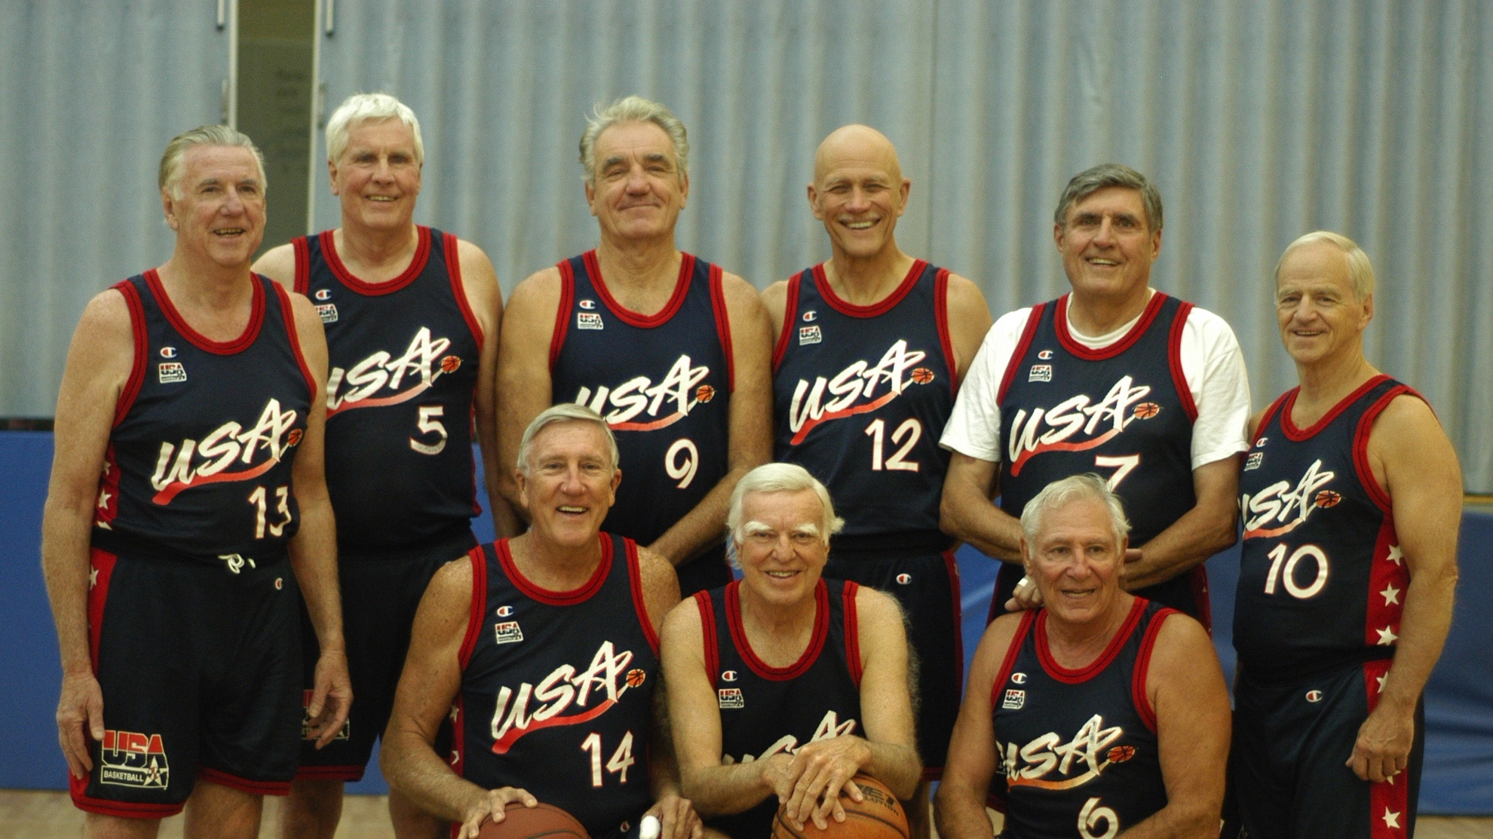
Thank You
WWW.IMGA.CH

