Slide 1
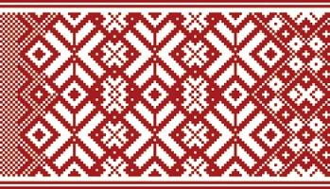

Latvian Veteran / Senior Sports Association LVSA
Latvijas Sporta veterānu - senioru savienība
www.lsvs.lv
09.02.2017
Laine Kreicere

Slide 2
SOME FACTS
The first official Latvian Sport Veteran Games were held in 1963.
Next year will be 55th local government Sport Veteran Games.
Our Sport Veteran Games are in:
22 sport categories and
13 different age groups: 30 year olds - 90 year olds.
12 - 15 regions of Latvia.

Slide 3
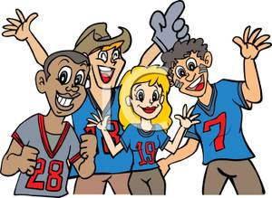
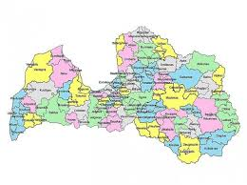
SOME FACTS
Participants are from 70 different regions (~16 nationalities living in Latvia). = Totaly more than 6000.

Slide 4
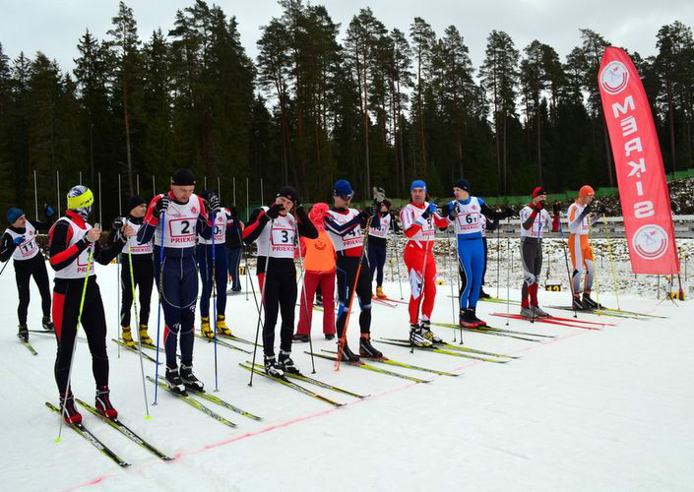
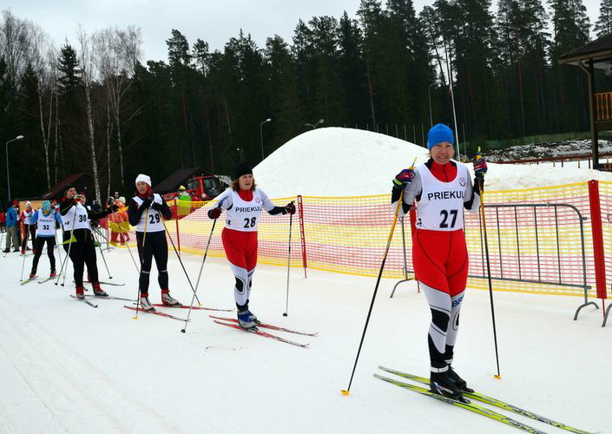
Latvian Sport Veteran Games
every year beginns in winter – February with Table Tennis (more than 140 participants, F 6 + M 6 age groups)
and Cross-Country Skiing (more than 100 participants, F 13 + M 12 age groups)

Slide 5
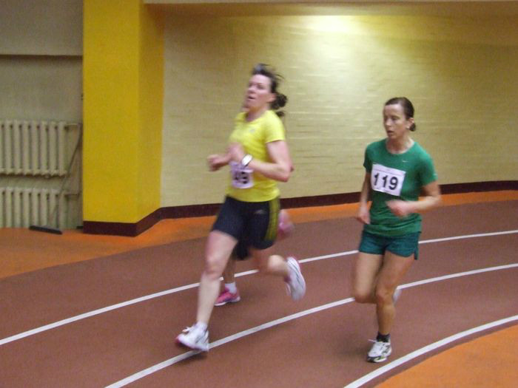
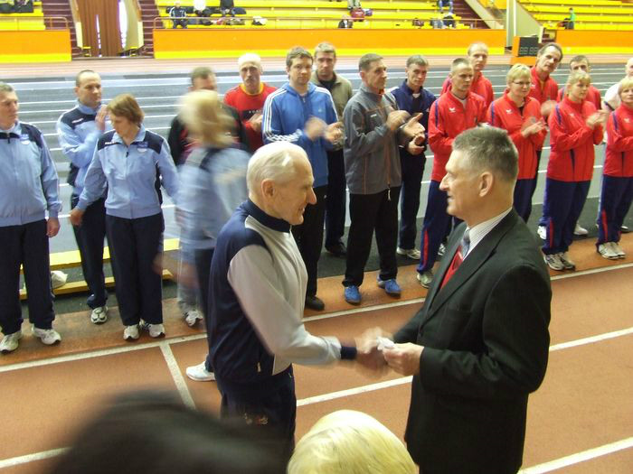
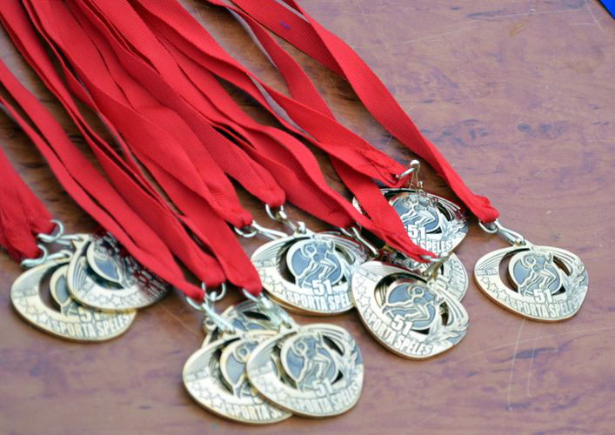
Latvian Sport Veteran Games
In March follows indoor:
Athletics
(more than 300 participants,
F 13 + M 12 age groups);
Ketlebell Lifting (~ 100 participants,
F 10 + M 10 age groups);

Slide 6
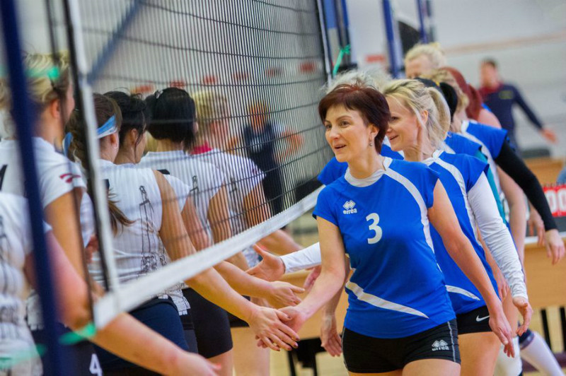
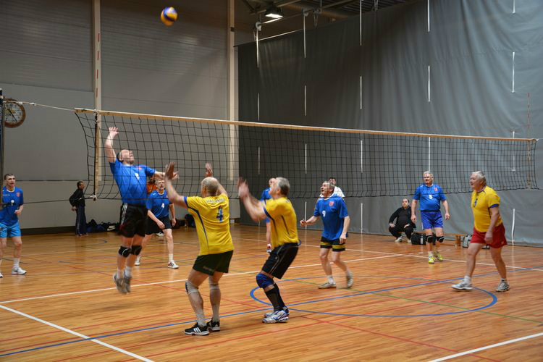
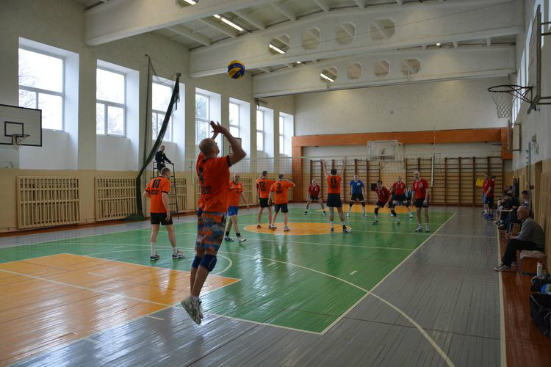
Latvian Sport Veteran Games
Volleyball (~ 55 teams
F 7 + M 8 age groups);

Slide 7
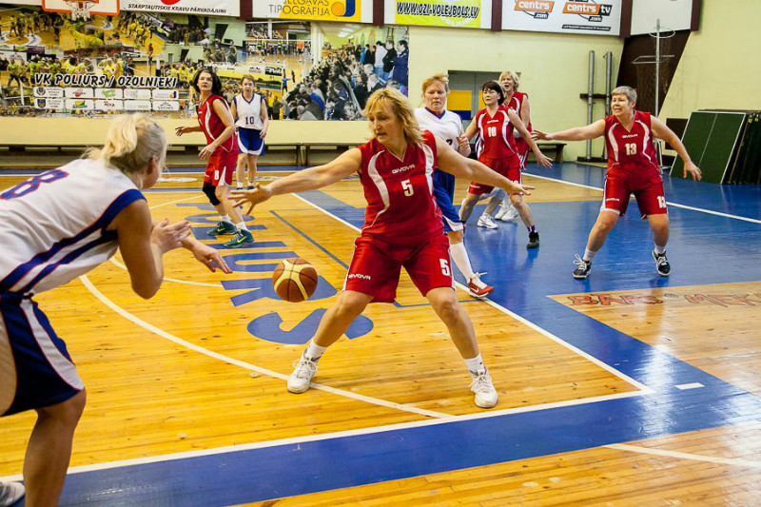
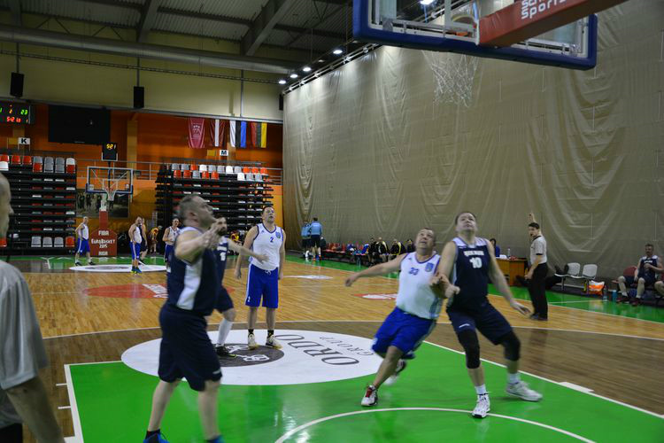
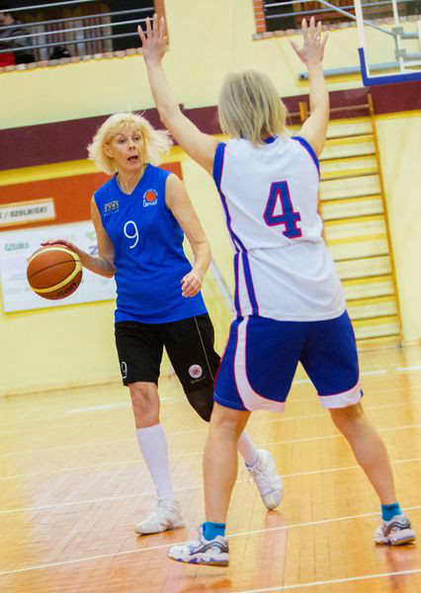
Latvian Sport Veteran Games
Basketball (~ 35 teams,
F 3 + M 3 age groups);

Slide 8
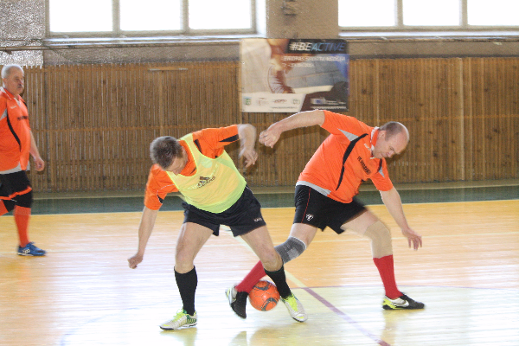
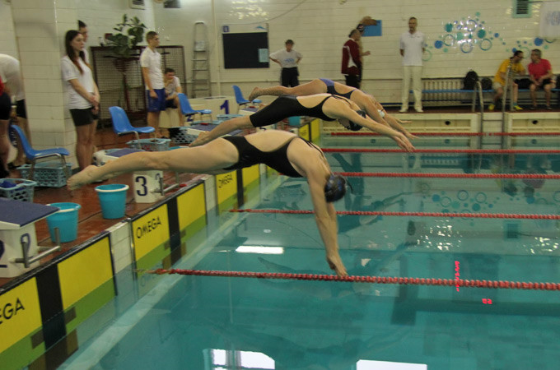
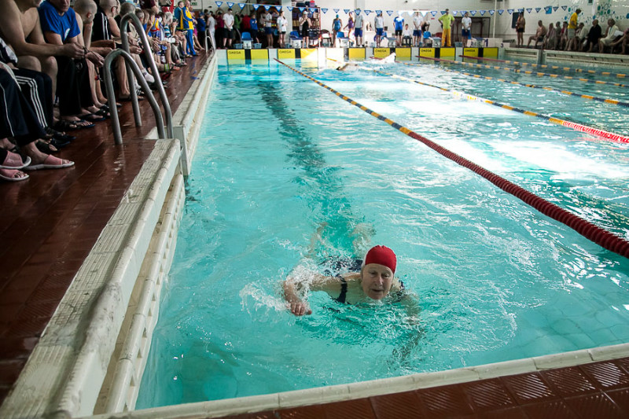
Latvian Sport Veteran Games
Indoor Football (~ 20 teams
M 2 age groups);
Swimming (~170 participants,
F 11 + M 11 age groups);

Slide 9
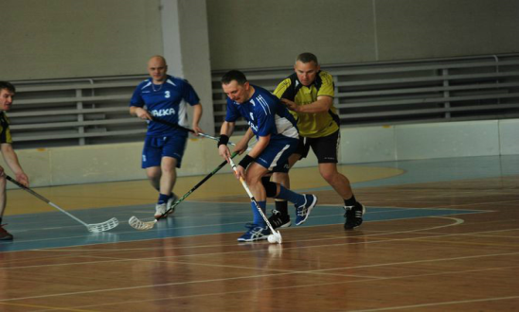
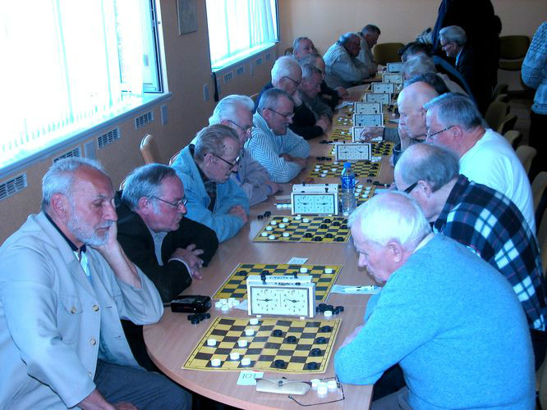
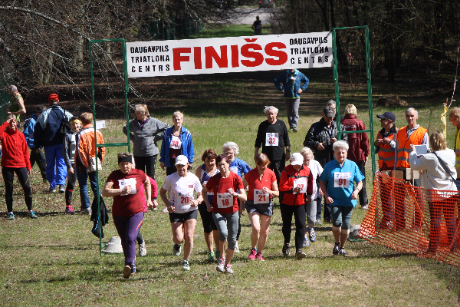
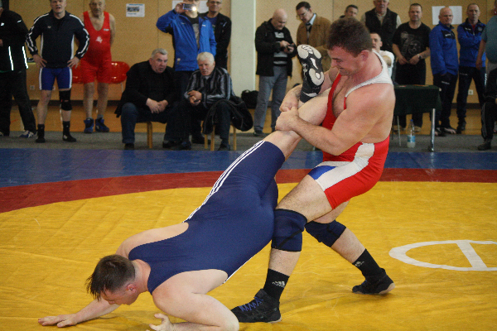
Latvian Sport Veteran Games
Every year in April will be held following competitions:
Finals in Floorball
(~ 8 teams, M 2 age groups);
Checkers (~ 85 participants,
F 3 + M 3 age groups);
Darts (~ 60 participants, F 1 + M 1 age groups);
Cross country
running
(~ 130 participants,
F 13 + M 12
Age groups);
Free Fight (~ 50 participants,
M 7 age groups).

Slide 10
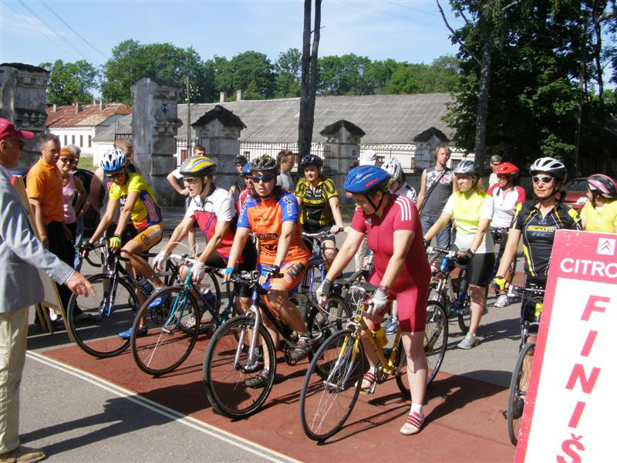
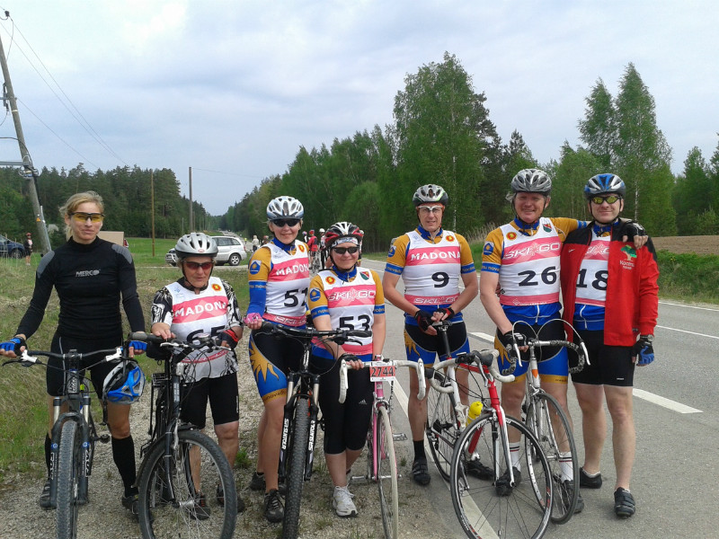
Latvian Sport Veteran Games
In May follows Finals in Cycling (~ 140 participants, F 10 + M 10 age groups);

Slide 11
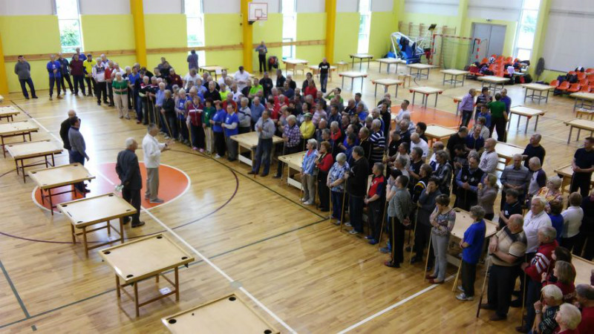
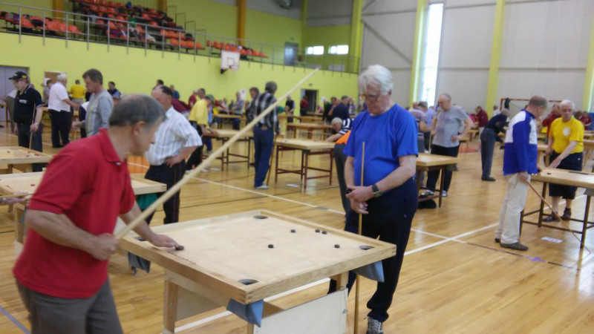
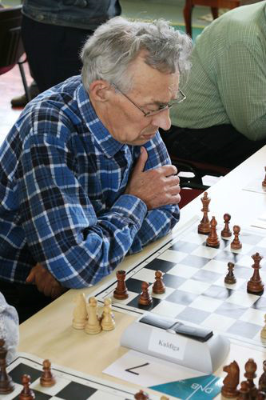
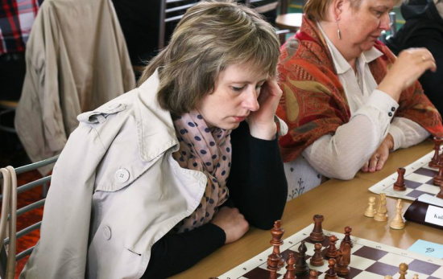
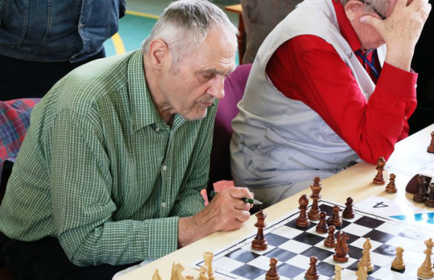
Latvian Sport Veteran Games
In June - Finals in Novus
(~ 230 participants, F 4 + M 4
age groups);
Archery (~ 45 participants, F 2 + M 2 age groups);
Finals in Chess (~ 130 participants, F 4 + M 4 age groups);

Slide 12
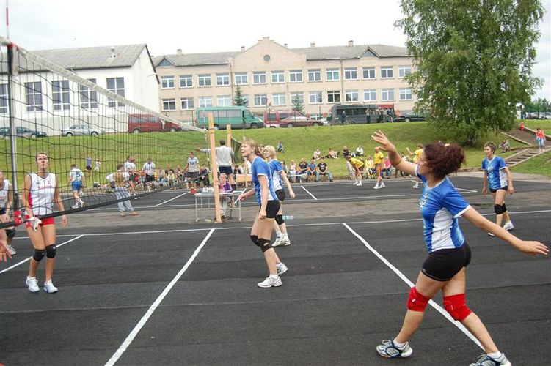
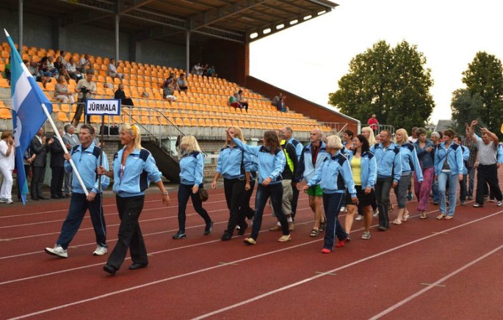
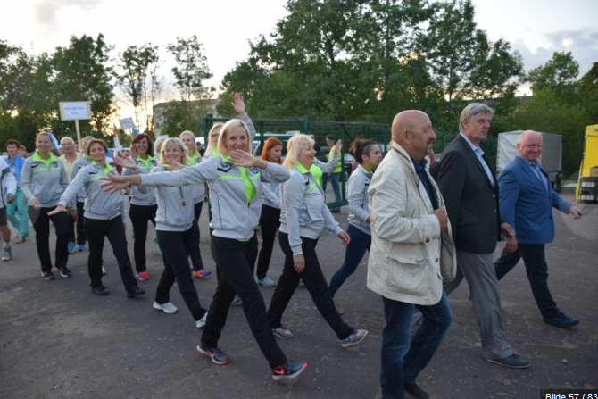
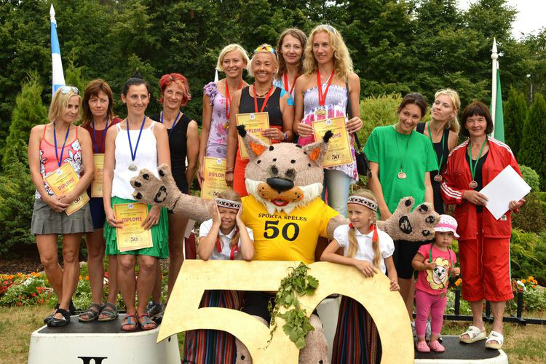
Latvian Sport Veteran Games
Orientation (~ 230 participants, F 11 + M 11 age
groups);
Beach Volleyball (~ 50 teams ,
F 4 + M 4 age groups).
July is celebration month for our Sport Games – End of Games with all finals in athletics, shooting, basketball, volleyball, minifootball, handball and with athletes parade and closing ceremony.

Slide 13
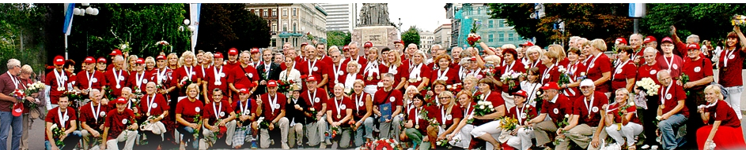
Latvian Sport Veteran Games
Our athletes participate also in Baltic, European and World competitions, for example: WORLD MASTERS GAMES, EUROPEAN MASTERS GAMES, etc. We are proud with Latvian sport veteran / senoir athletes.
From 1989 to 2016 Latvian veterans have won 3035 medals in World and European Veteran Championships and in World Masters Games promoting Latvia’s name in the world.

Slide 14
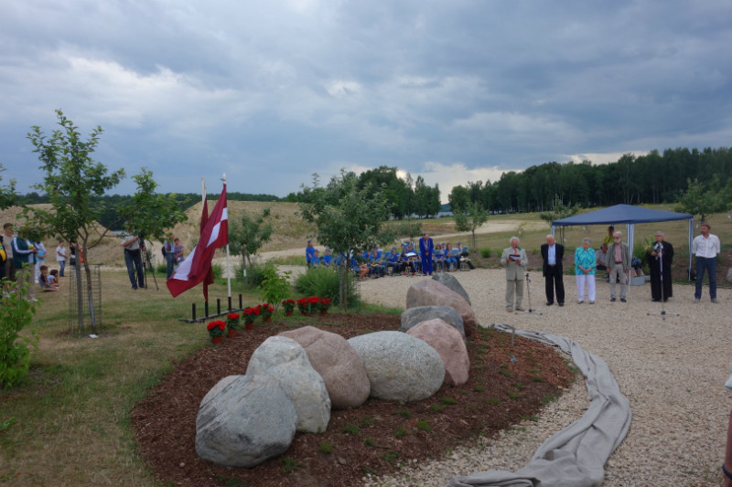
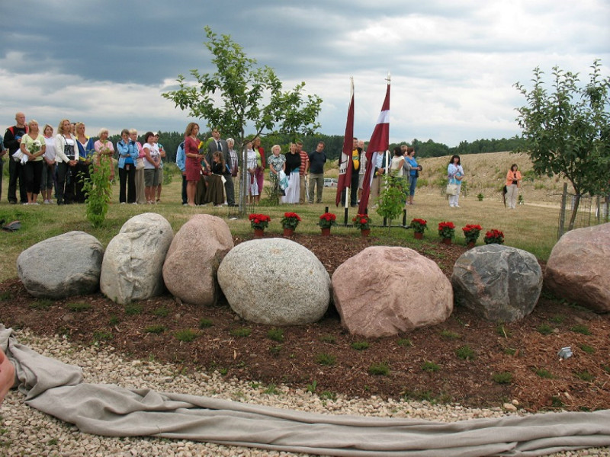
Latvian Sport Veteran Games
We have a garden commemorating the strength of our nation. We have created memorials for outstanding athletes. We are currently working towards welcoming Latvian sports veterans from around the world at the Garden of Destiny in 2018, the 100th anniversary of Latvia.

Slide 15

Latvian Sport Veteran Games
Latvian Veteran / Senior Sports Association LVSA congratulate Estonian Senior sport and Sport Veterans Union to 50th anniversary!
Läti Seeniorspordi ja Spordiveteranide Liit LVSA õnnitleb Eesti Seeniorspordi ja Spordiveteranide Liitu tema 50.-ndal sünnipäeval!
We would like to invite you to Latvia’s 54th Veteran and Senior Sport Games, which are dedicated to Latvia’s 100 year birthday in 2018!
Thank you! Aitäh!

